Slide 1
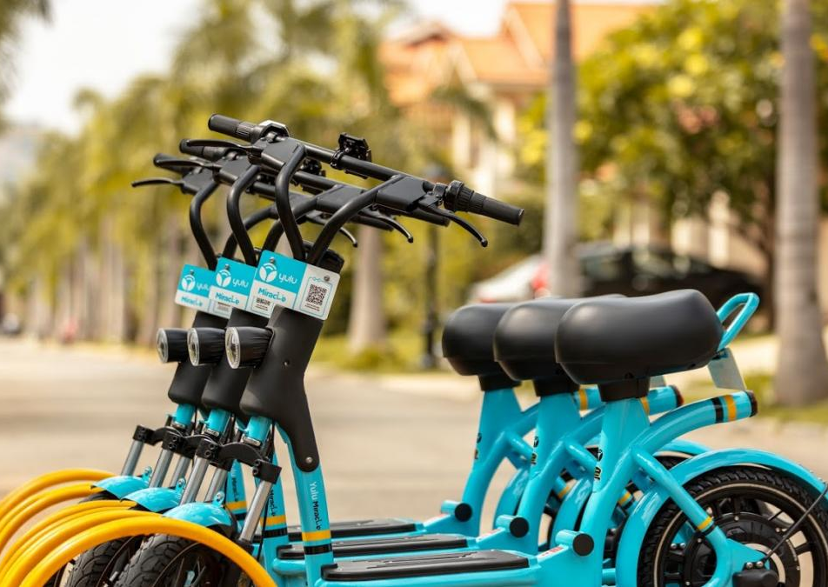
Demand Analysis for Bike Sharing Platform
Group Members:
Ansh Aya
Deep Gada
Vaidehi Patole
Hari Babu Muga
10/25/2020

Slide 2
Contents
Introduction
Business Questions
Analysis
Conclusion

Slide 3

Introduction
The project is focused on analyzing bike sharing system to get insights on demand of bike rentals. Various business questions were explored by performing analysis using data visualization tool, tableau. The visualizations provided an efficient display of the key performing indicators affecting demand growth. The dataset used for the project consists of basic information regarding bike rentals such as year, month, week, day, date and season when the bikes were rented along with the climatic conditions.

Slide 4

Business Questions
What is the best season for bike rentals?
Is there any difference in demand for bike rentals between casual and registered users?
How does the usage of bikes change as the wind speed changes throughout the year?
What is the effect of temperature and humidity on demand of bike rentals?
Which weather conditions are ideal for renting a bike?

Slide 5
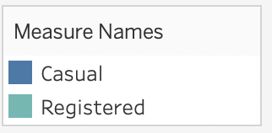
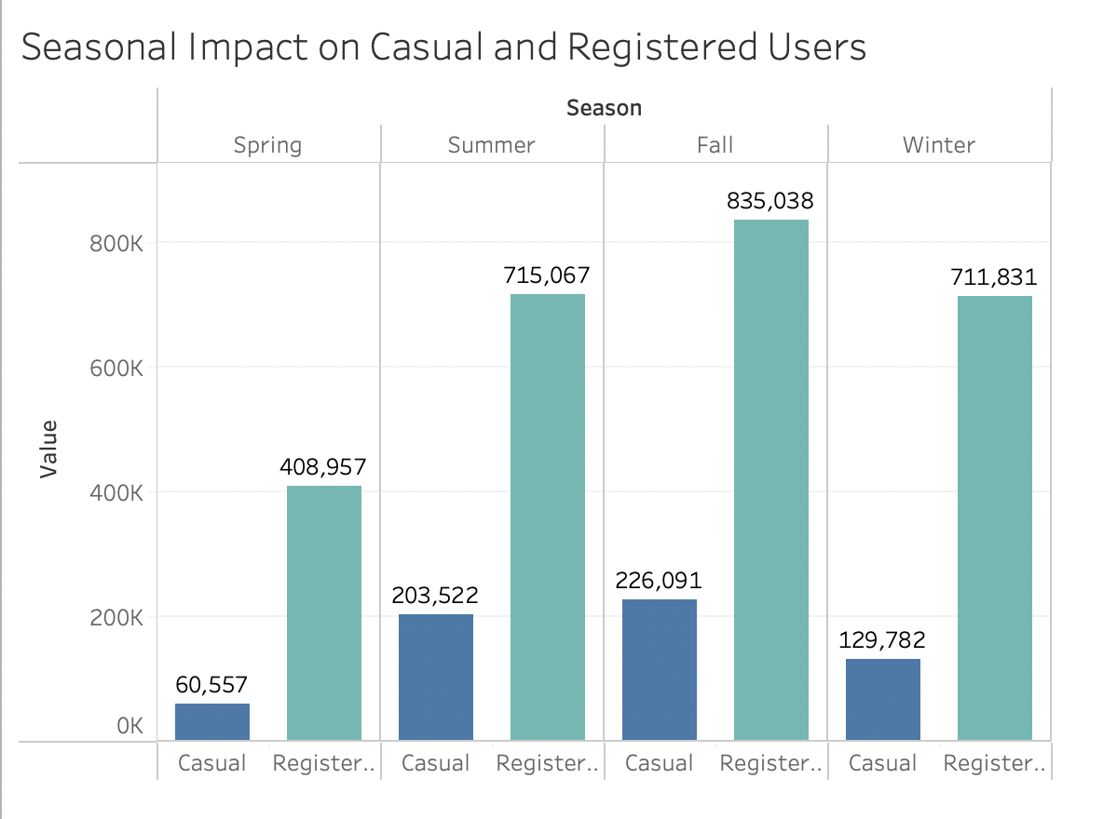
An extensive view of number of casual and registered users with respect to seasons.
The season of fall, has the highest number of users for both types.
The season of spring, has the least number of casual and registered users.

Slide 6
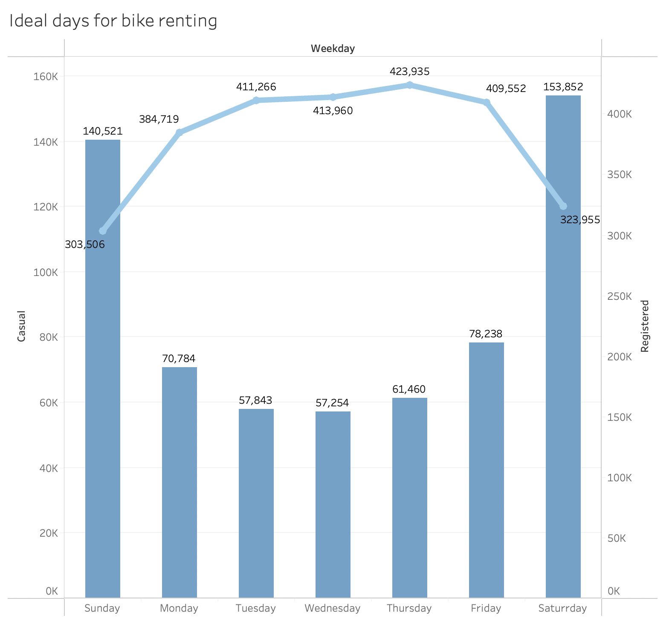
The days typically preferred by casual and registered users to hire bikes.
The weekend (i.e., Saturday and Sunday) has the highest number of casual users renting bikes
Whereas the registered users are observed preferring weekdays for renting bikes

Slide 7
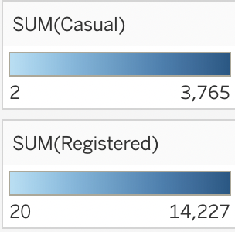
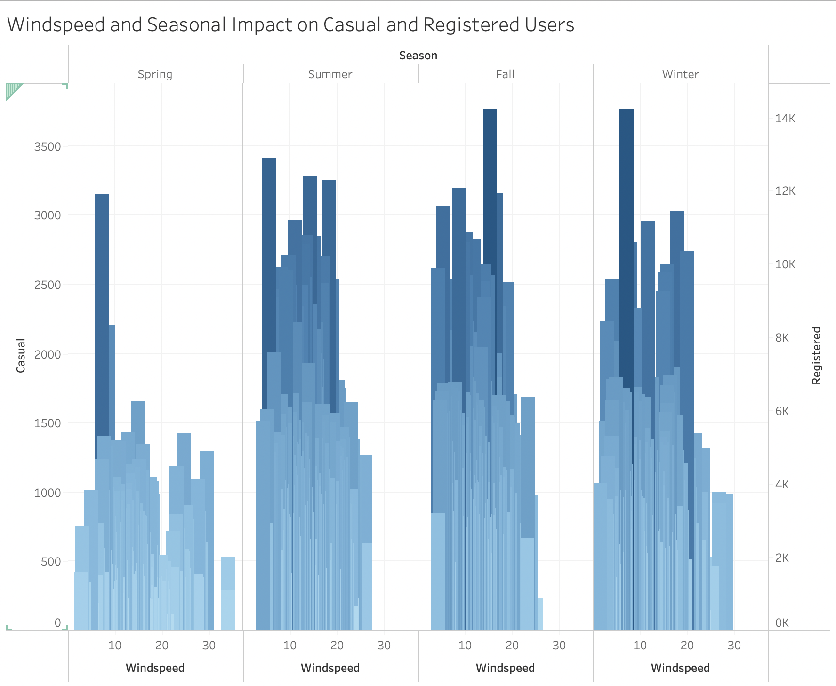
The effect of the season and wind speed on bike rentals in detail.
Both types of users, casual and registered choose the fall as the best time to hire bike.
The ideal days for casual and registered users to rent bikes tend to have windspeed between 10 and 20 mph.
When wind speed increases, the usage of bikes decreases.

Slide 8
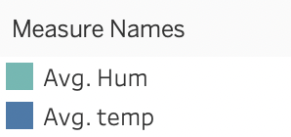
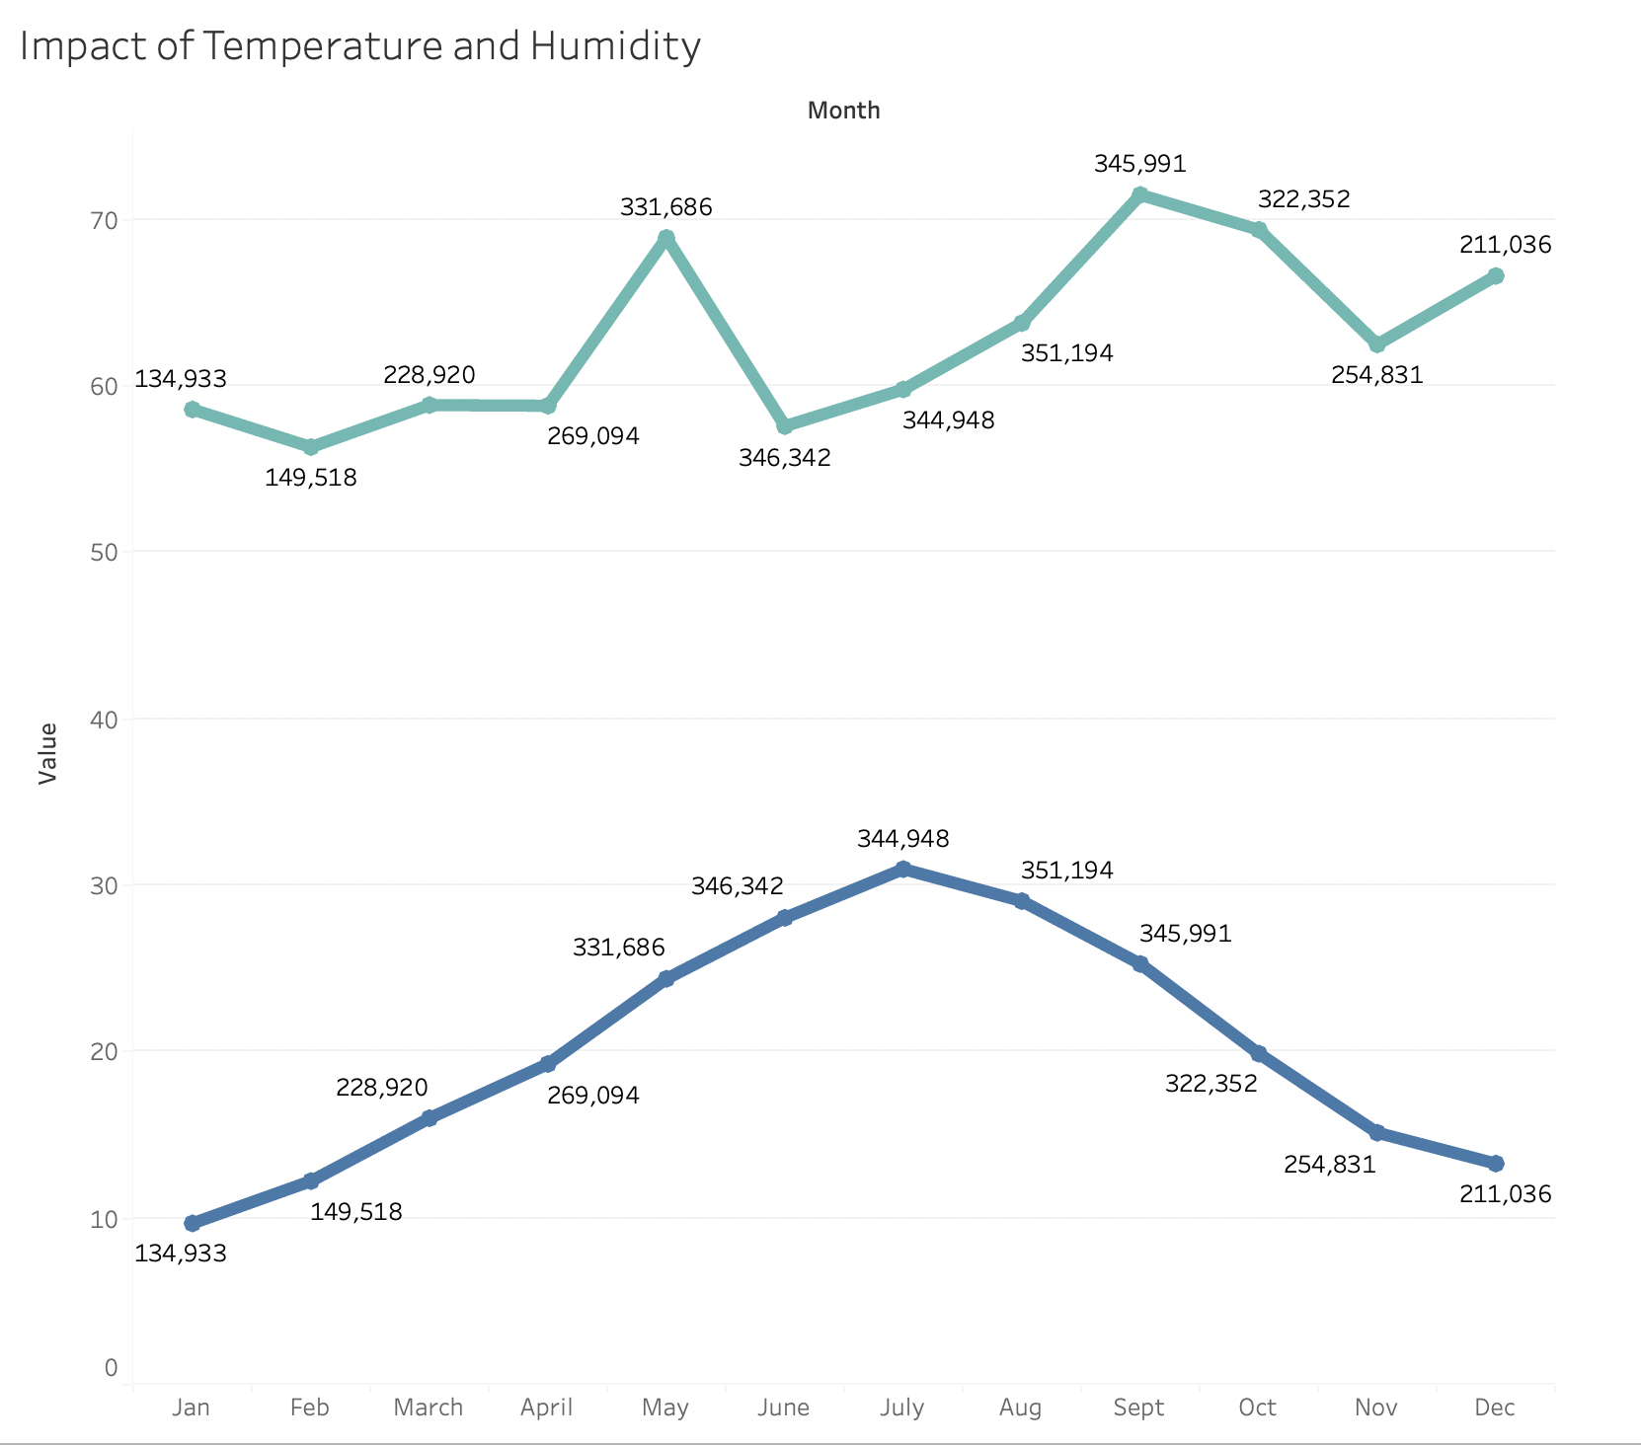
Variance in temperature and humidity throughout the year.
Highest count of users renting bikes is observed in the months of June to August.
During this period, the average temperature is found to be highest and average humidity is found to be low.

Slide 9
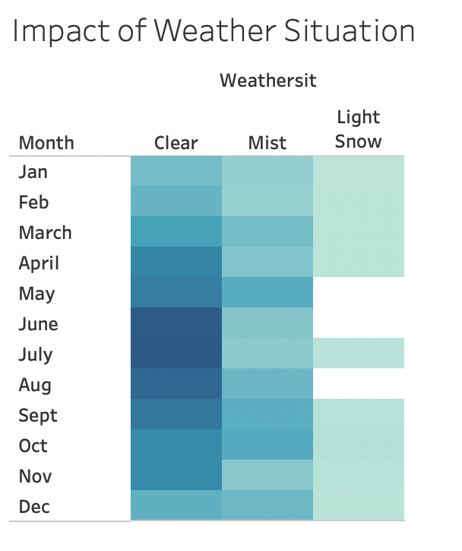
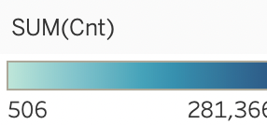
The weather situation affecting bike rentals.
The clear weather is found to be the best situation for bike rentals especially in the months of June – August.
Whereas the light snow is the least preferred weather situation.

Slide 10
Conclusion
The insights derived from the analysis successfully meets the requirements proposed in business questions. The best time of the year to rent bikes has been determined to be the fall. It was discovered that registered users prefer renting bikes on weekdays, whereas casual users prefer weekends. Furthermore, the study discovered that the demand for bike rentals is significantly influenced by climatic factors including temperature, humidity, and wind speed.
By detecting usage trends for bike rentals, this demand analysis will help to increase customer satisfaction. This will in turn improve supply planning and marketing, leading to an overall increase in the growth of the bike rental business.

Slide 11
Thank you
Q/A

